Slide 1


Continuous Integration
[ Advanced ]
Presenter
Mohammad Anees Alam
Notes:
1

Slide 2






Topics for today!
Recap: Build & test automation
Overview of test types
Artifact Management
Notification & reporting in CI
Different CI/CD env's
CI optimization & best practices
Notes:
2

Slide 3
Importance of building & testing in CI
Automated builds play a vital role in modern software development by simplifying code compilation, dependency management, and application packaging. They help ensure that software is consistently in a deployable state, reducing manual effort and errors.
Automated Build
Automated Testing
Early Issue Detection – Identifies errors in code integration, dependencies, and configurations before deployment, reducing late-stage failures.
Quality Assurance – Detects bugs early, ensuring software stability and reliability.
Efficiency and Speed – Automates repetitive tasks, speeding up development and allowing faster feedback loops.
Efficiency and Speed – Runs tests automatically on every change, providing quick validation.
Consistency – Ensures every build follows the same process, reducing environment discrepancies and deployment issues.
Comprehensive Coverage – Supports unit, integration, and regression testing to cover all scenarios.
Faster Releases – Speeds up development and deployment cycles.
Reduced Manual Effort – Minimizes repetitive manual testing, freeing up resources for critical tasks.
Improves Collaboration – Developers can work together without breaking the build.
Improved Collaboration – Provides automated feedback to developers, ensuring only tested code is merged.
Notes:
3

Slide 4
YML file Structure for CI/CD
  YAML (.yaml) & YML (.yml) are the same — just different file extensions. There’s no technical difference, .yaml is more standard, but .yml is still widely used!
  YML file is used to define workflows in build automation tools, It follows a key-value format with indentation.
name:
on:
jobs:
steps:
Workflow Name
Triggers the Workflow
Defines Jobs to Run
Tasks Inside a Job
Defines the name of the workflow.
Each CI/CD pipeline consists of multiple jobs.
Each job has sequential steps that run built-in commands (run:) or use reusable GitHub Actions (uses:).
Specifies when the workflow should run.
runs-on: Selects the Runner OS
env: Defines Env Variables
needs: Define Job Dependencies
Used to store reusable environment variables.
Specifies the environment for execution (e.g., Ubuntu, Windows, macOS).
Ensures a job runs only after another job completes.
Notes:
4

Slide 5
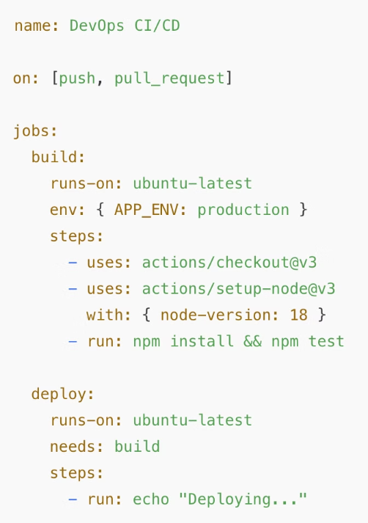
Sample .YML file:
A simple GitHub Actions YAML file for a DevOps workflow that builds and deploys a project.
Workflow Name (name:) → Defines the workflow name
Event Triggers (on:) → Runs on push & pull_request events
Jobs (jobs:) → Defines build and deploy jobs
Steps inside Jobs (steps:) → Runs checkout, setup, install, test, and deploy steps
Environment Variables (env:) → Defines APP_ENV variable
Dependencies (needs:) → Ensures deploy runs only after build completes.
Notes:
5

Slide 6







Types of Tests in CI
In Continuous Integration (CI), several types of tests are used to ensure software quality and reliability.
Unit Tests
Integration Tests
Ensure each part of the code works as expected.
Detect issues when modules interact with databases, APIs, or external services.
2
1
End-to-End Tests
Smoke Tests (Sanity Checks)
3
Identify issues in UI, backend, and third-party integrations.
Quick tests to check if critical features work before running extensive tests.
7
4
Performance Tests
6
Helps identify bottlenecks and optimize system performance.
5
Regression Tests
Ensure that new code changes do not break existing functionality.
Security Tests
Helps prevent data breaches and security threats.
Notes:
6

Slide 7

Artifact Management
  In the context of CI/CD, Artifacts primarily store successful build outputs but can also capture logs or reports for failed builds to help with troubleshooting.
  Artifacts are crucial in CI/CD pipelines as they are the tangible outputs that are tested, validated, and eventually deployed to users.
  Managing them efficiently ensures consistency in deployments.
Real-World Use Case: Docker Hub is used to store and distribute containerized services.
Why are Artifact important ?
1
Consistent Deployments
2
Faster Rollbacks
3
Efficient Storage & Distribution
4
Security & Compliance
Notes:
7

Slide 8






Popular Artifact Repositories
AWS S3 / GCP
Nexus Repository
Docker Hub
Stores and distributes Docker images.
Used for cloud-based artifact storage.
Stores binaries, dependencies, and container images.
Jenkins Artifacts
Jfrog Artifactory
Stores artifacts in the Jenkins workspace.
Supports multiple package formats.
Notes:
8

Slide 9
Hands-on Activity!
Let's analyze a workflow that creates, stores, and retrieves an artifact to demonstrate artifact management in GitHub Actions.
1
Trigger - push
Runs when code is pushed to the repository.
2
Job - 1 : build
  Checks out the code.
  Creates an output directory and adds a file (artifact.txt).
  Uploads this file as an artifact.
3
Job - 2 : download
  Runs after the build job completes.
  Downloads the stored artifact.
  Lists and displays its content for verification.
Troubleshooting Tip: Check repository permissions and CI pipeline logs.
Notes:
9

Slide 10

Notifications & Reporting in CI
Continuous Integration (CI) notifications and reporting are essential for keeping teams informed about build status, test results, and deployment progress.
They help detect failures early and ensure smooth collaboration.
Importance of Notifications in CI
—
—
—
—
Immediate Feedback
Faster Issue Resolution
Improved Collaboration
Automated Alerts
Notes:
10

Slide 11
Common Notification Channels
Email Alerts
Webhook Notifications
Sends build reports directly to developers.
Sends data to monitoring tools or custom dashboards.
1
2
3
4
Slack/MS Teams
GitHub/GitLab Notifications
Integrates with chat platforms for real-time alerts.
Displays CI/CD statuses within the repository.
Reporting in CICD pipelines
Test Reports
Build Logs
Summarizes unit, integration, and functional test results.
Provides detailed logs for debugging.
1
2
3
4
Code Coverage Reports
Performance metrics
Highlights how much code is tested.
Tracks build times and test execution speed.
Notes:
11

Slide 12
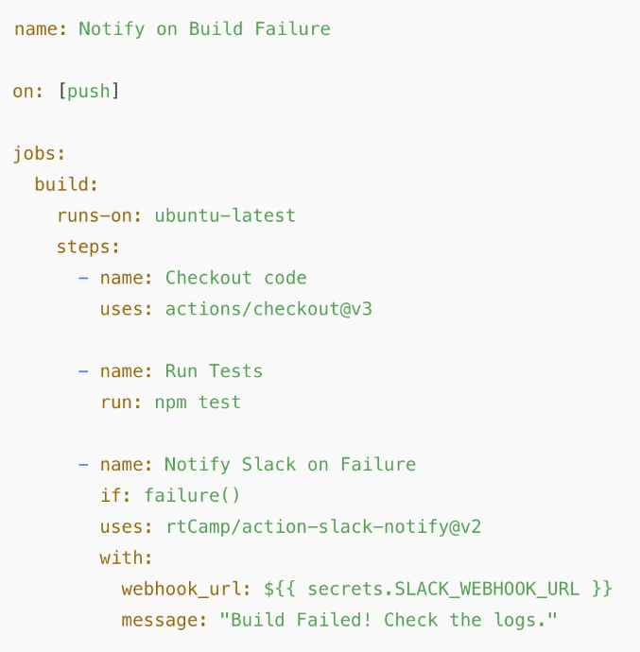
Let's analyze a sample code !
Automatically notify the team in Slack when a build fails, so they can quickly investigate and fix the issue.
Workflow Breakdown:
  Trigger Event (on: push)
    The workflow runs whenever code is pushed to the repository.
  Build Job (jobs: build)
    Runs on an Ubuntu environment (runs-on: ubuntu-latest).
  Steps inside the Job:
    Checkout Code: Pulls the latest repository code using actions/checkout@v3.
    Run Tests: Executes npm test to check for any code issues.
    Slack Notification on Failure:
      If the test fails (if: failure()), it triggers a Slack notification.
      Uses rtCamp/action-slack-notify@v2 to send a message.
      The webhook URL is stored as a secret (SLACK_WEBHOOK_URL) to securely send notifications.
Notes:
12

Slide 13

Best Practices for Notifications & Reporting
1
Use Relevant Channels
2
Automate Failures & Success Alerts
3
Store Reports for Future Analysis
4
Integrate with Monitoring Tools
Notes:
13

Slide 14
Different Environments in CI/CD
CI/CD pipelines use multiple environments to ensure software quality before production.
Each stage ensures reliable software delivery with minimal disruptions.
1
2
3
4
Test Suite
OneBox
Beta/Gamma
Production
  Runs automated tests (unit, integration, functional).
  Allows for safe experimentation without affecting other environments.
  Pre-production testing environments.
  The live, user-facing environment.
  Beta: Limited user testing for feedback.
  Requires stability, security, and monitoring.
  Detects bugs early in isolated environments.
  Used by developers to validate changes before merging.
  Gamma: Internal validation before release.
Notes:
14

Slide 15




Exercise: Setting Up Multiple Environments in CI/CD
  Create a CI/CD pipeline in GitHub Actions that simulates different environments (Test Suite, OneBox, Staging, and Production).
  This will help you understand how to structure a workflow for different release stages.
Breakdown of the Workflow :
Workflow Name & Trigger
The workflow is named "Multi-Environment CI/CD" (name:).
It is triggered by a push event (on: [push]).
Jobs Defined (jobs:)
The workflow contains 4 jobs, each running sequentially:
test-suite (1st job)
onebox (2nd job, depends on test-suite)
staging (3rd job, depends on onebox)
production (4th job, depends on staging)
  Checks out the code.
  Runs unit and integration tests.
  Deploys the application to an isolated OneBox environment.
  Deploys the application to a staging environment (Beta/Gamma).
  Deploys the final version of the application to production.
  Ensures the code is stable before moving to the next stage.
  Helps developers test their changes in a controlled space.
  Used for testing with real-like conditions before production.
Things to Observe:
    Job Dependencies → needs: ensures that each stage waits for the previous one to complete.
    Simulated Delays (sleep 3) → Mimics actual deployment/testing time.
Notes:
15

Slide 16
CI Optimization and Best Practices
  Optimizing Continuous Integration (CI) improves build speed, resource efficiency, and development workflow.
  A well-structured CI pipeline minimizes delays, enhances reliability, and streamlines software delivery.
Common CI Bottlenecks and Solutions :
Slow Builds
Overloaded Pipelines
Manual Failover
Use caching and parallel testing.
Keep pipelines modular and efficient.
Implement automated rollbacks.
Best Practices for CI Optimization :
Parallelization
Caching
Streamlined pipelines
Continuous Optimization
Run tests and builds concurrently for faster execution.
Store dependencies and artifacts to reduce redundant processing.
Remove unnecessary steps and automate testing, deployment, and monitoring.
Regularly analyze CI performance and refine processes.
Notes:
16

Slide 17

Conclusion
  Test Types in CI: Automated tests (unit, integration, functional) ensure early bug detection and software reliability.
  Artifact Management: Storing, versioning, and managing build artifacts improves deployment consistency and traceability.
  Notification & Reporting in CI: Real-time alerts and comprehensive reports enable faster issue resolution and better decision-making.
  Different CI/CD Environments: Staged environments (Test, OneBox, Staging, Production) ensure stability, risk mitigation, and controlled rollouts.
  CI Optimization & Best Practices: Caching, parallel execution, modular workflows, and automation enhance CI efficiency and speed.
Notes:
17

